Slide 1
USA Contracts
Aaron Fleming, Junior Lepe, Jorge Gonzalez, Omar Ali

Slide 2
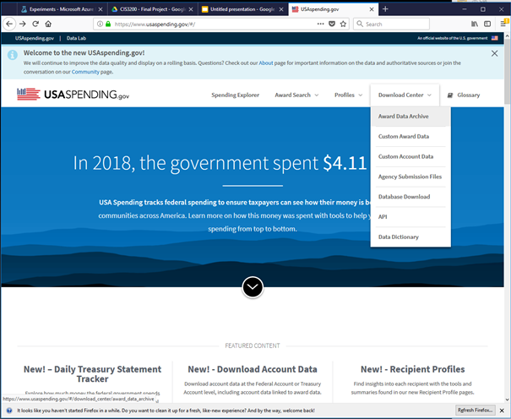
Dataset
https://files.usaspending.gov/award_data_archive/2018_all_Contracts_Full_20190409.zip
Total Size: 8.08GB
Portion Used: 269MB (was smallest of the 6 CSV files)

Slide 3
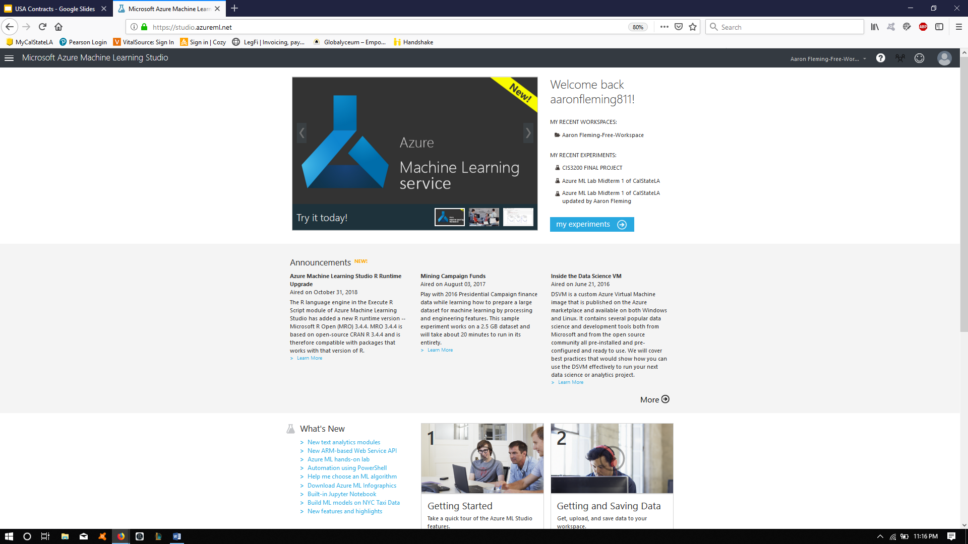
Specifications
Enough space on hard drive to download dataset
Azure ML Studio
Applicable browser
Internet access

Slide 4
Why this dataset?
This dataset includes data about contract awards distributed by US departments for specific goods and services.
Purpose:
Discover the frequency to which US funding is being sent to recipients and the total value given to said recipients for given contracts.
Attempt to make a prediction as to how much funding is going to a given recipient.
Here’s a fact, As of 2011 till now, the federal government spends about 6.85 million dollars per minute.
How it helps:
This can help predict future recipient funding to create a predictive budget.

Slide 5
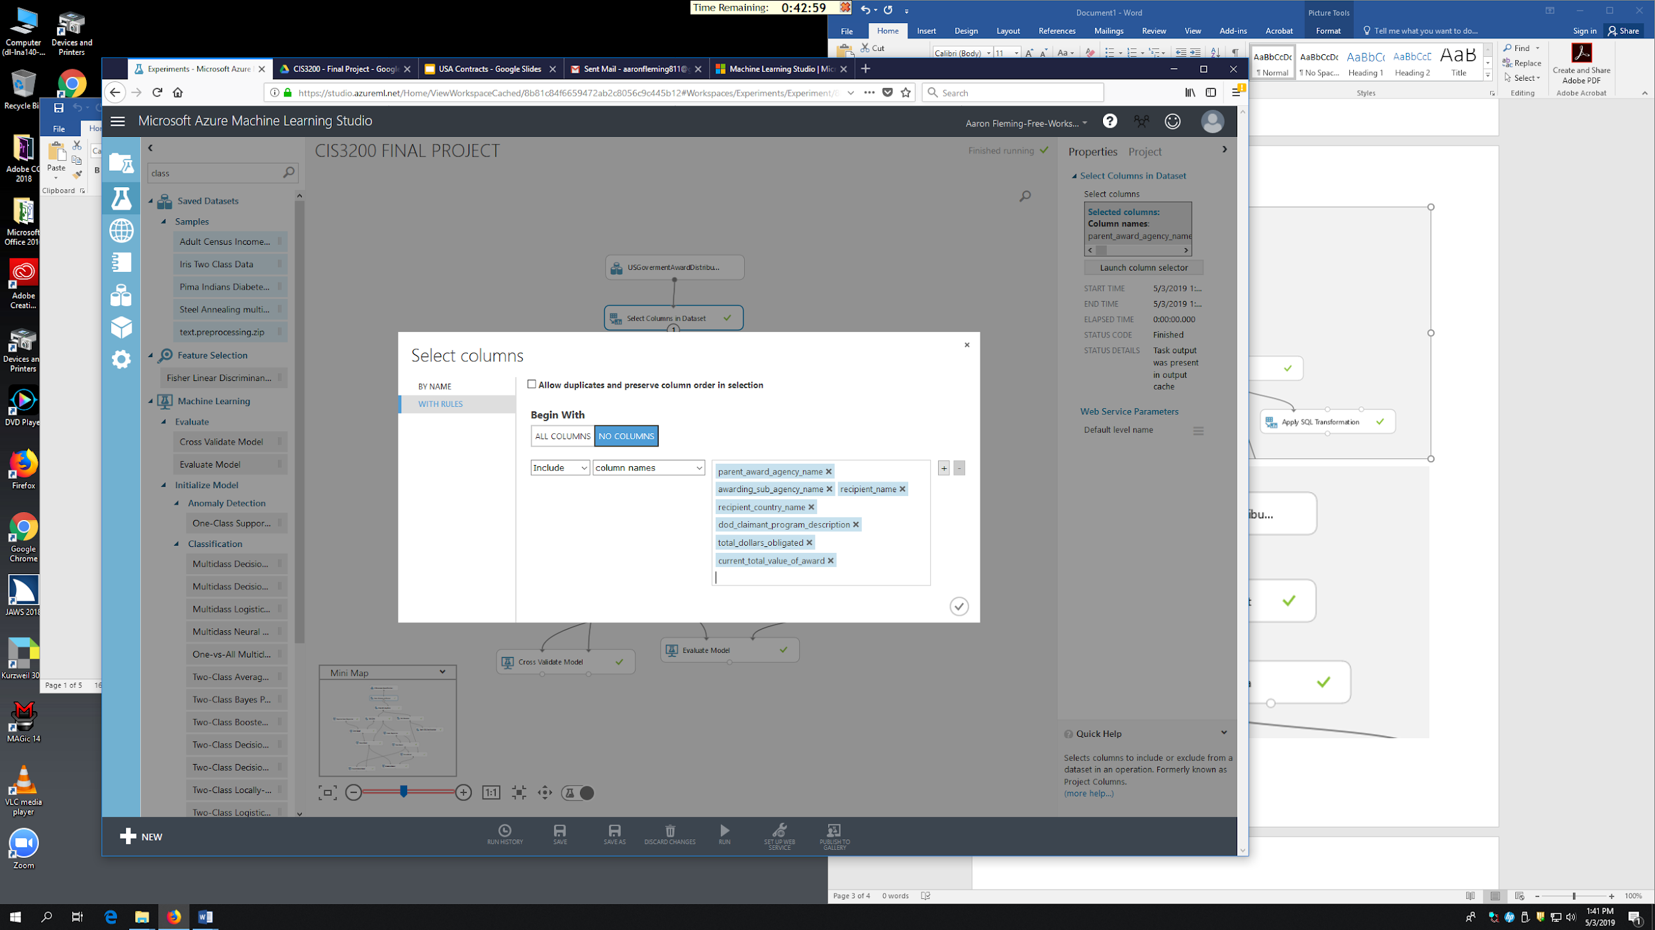
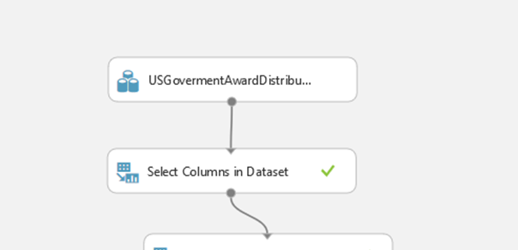
Select Columns in Dataset
Remove any excess and unnecessary columns
Some rows named differently but with same purpose
Ex: parent_award_agency_name and awarding_agency_name

Slide 6
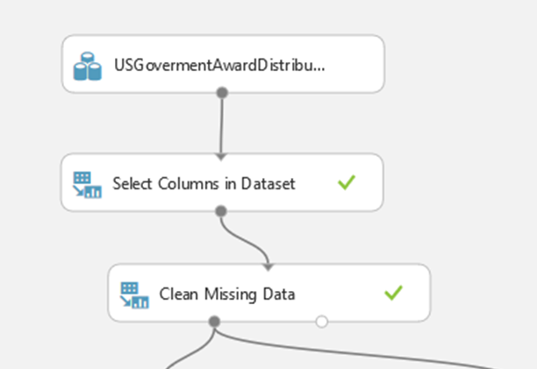
Clean Missing Data
All columns
Minimum missing value range: 0
Maximum missing value ratio: 1
Cleaning mode: Remove entire row
This is to ensure that no columns with an empty value will remain.

Slide 7
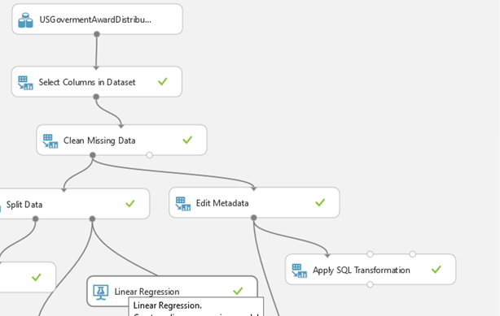
Edit Metadata
Column names: total_dollars_obligated
Data type: Floating point
Categorical: Unchanged
Fields: Unchanged
New column names: Empty
Making the total_dollars_obligated a floating point allows us to add the values together in the SQL transformation.

Slide 8
SQL Transformation
select parent_award_agency_name, recipient_name, recipient_country_name, dod_claimant_program_description, sum(total_dollars_obligated)
from t1
group by parent_award_agency_name, recipient_name, recipient_country_name, dod_claimant_program_description;

Slide 9
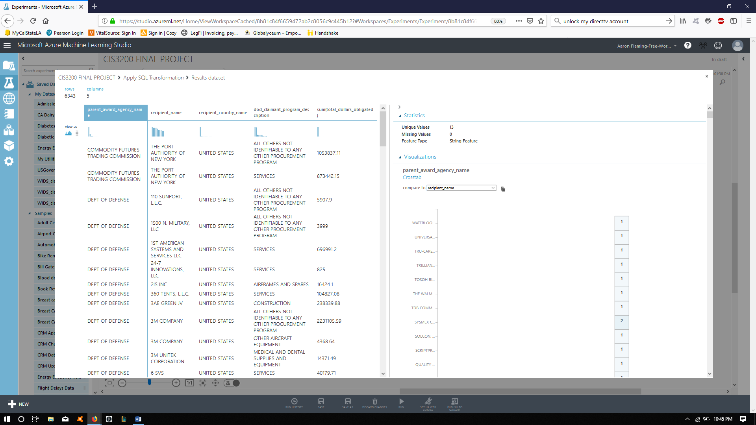

Slide 10
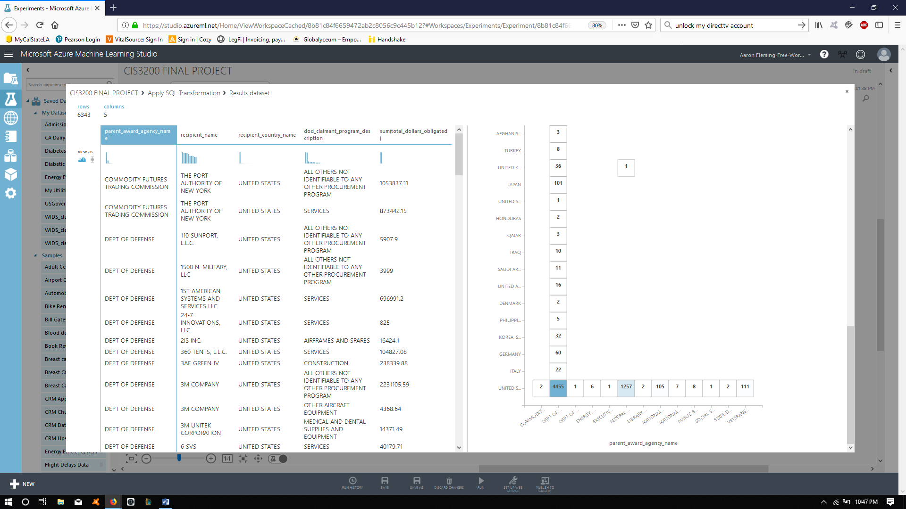

Slide 11


Slide 12
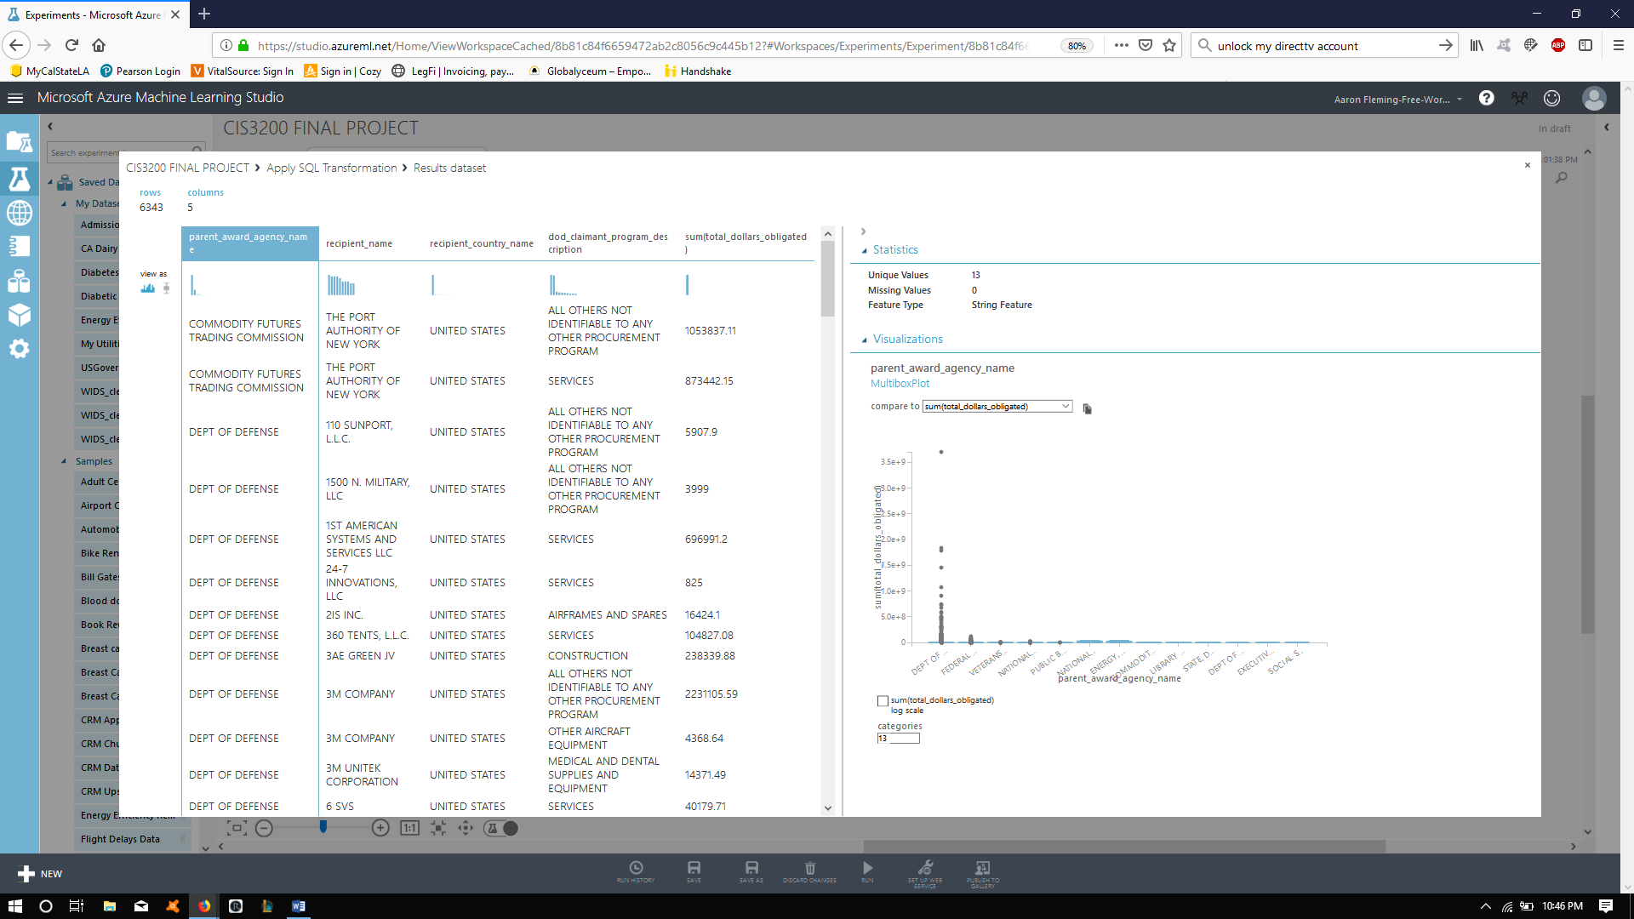

Slide 13
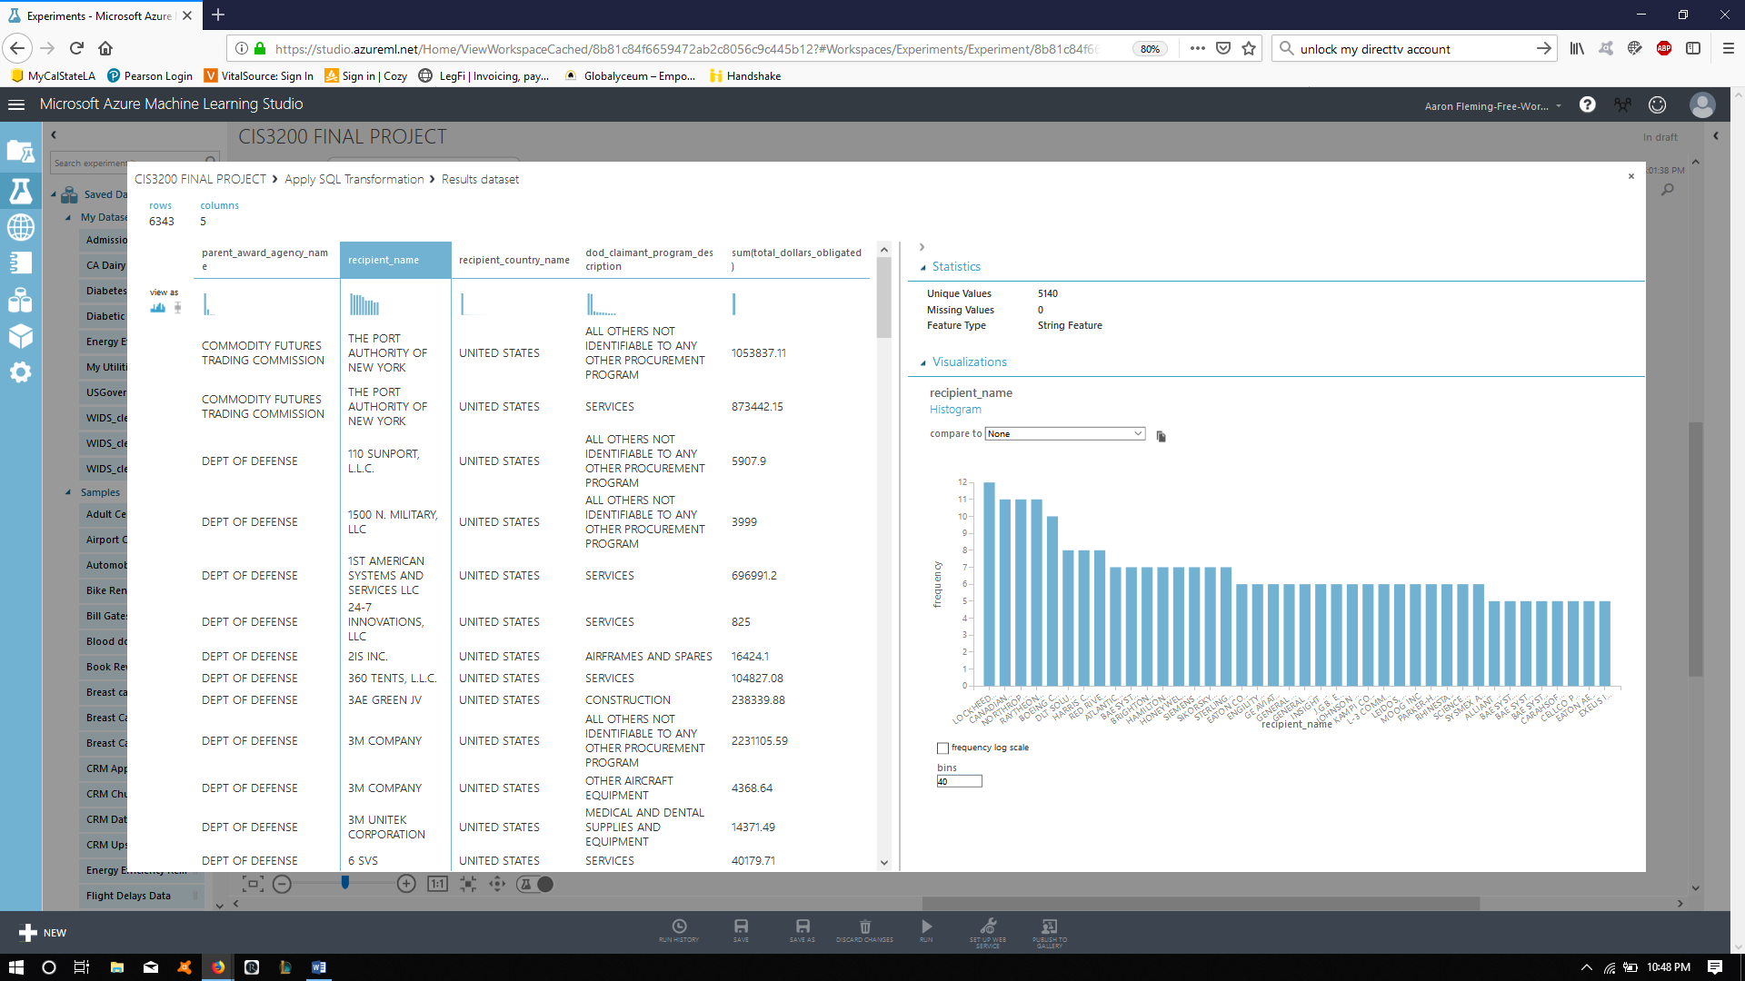

Slide 14
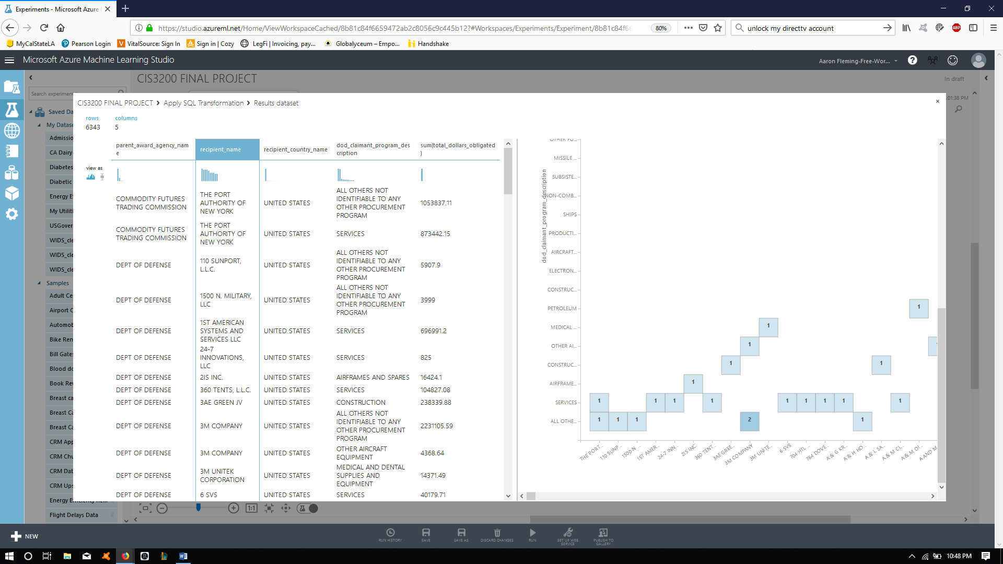

Slide 15


Slide 16
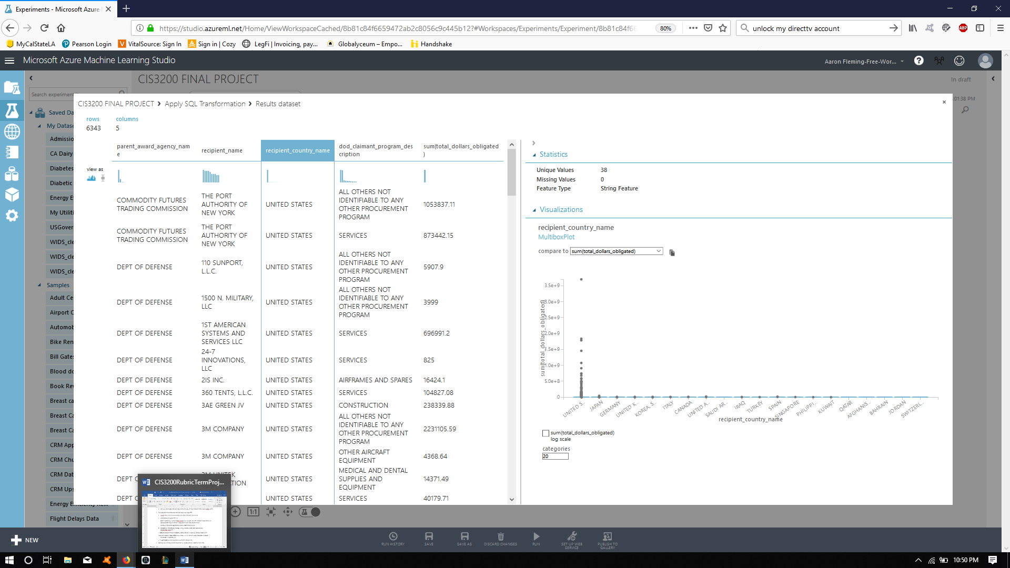

Slide 17
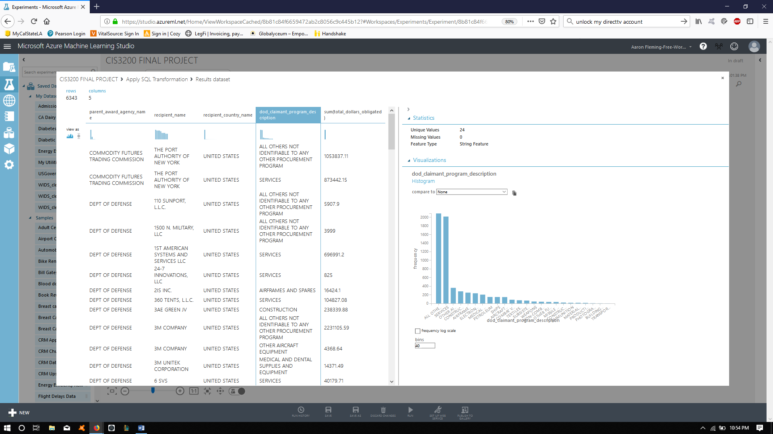

Slide 18
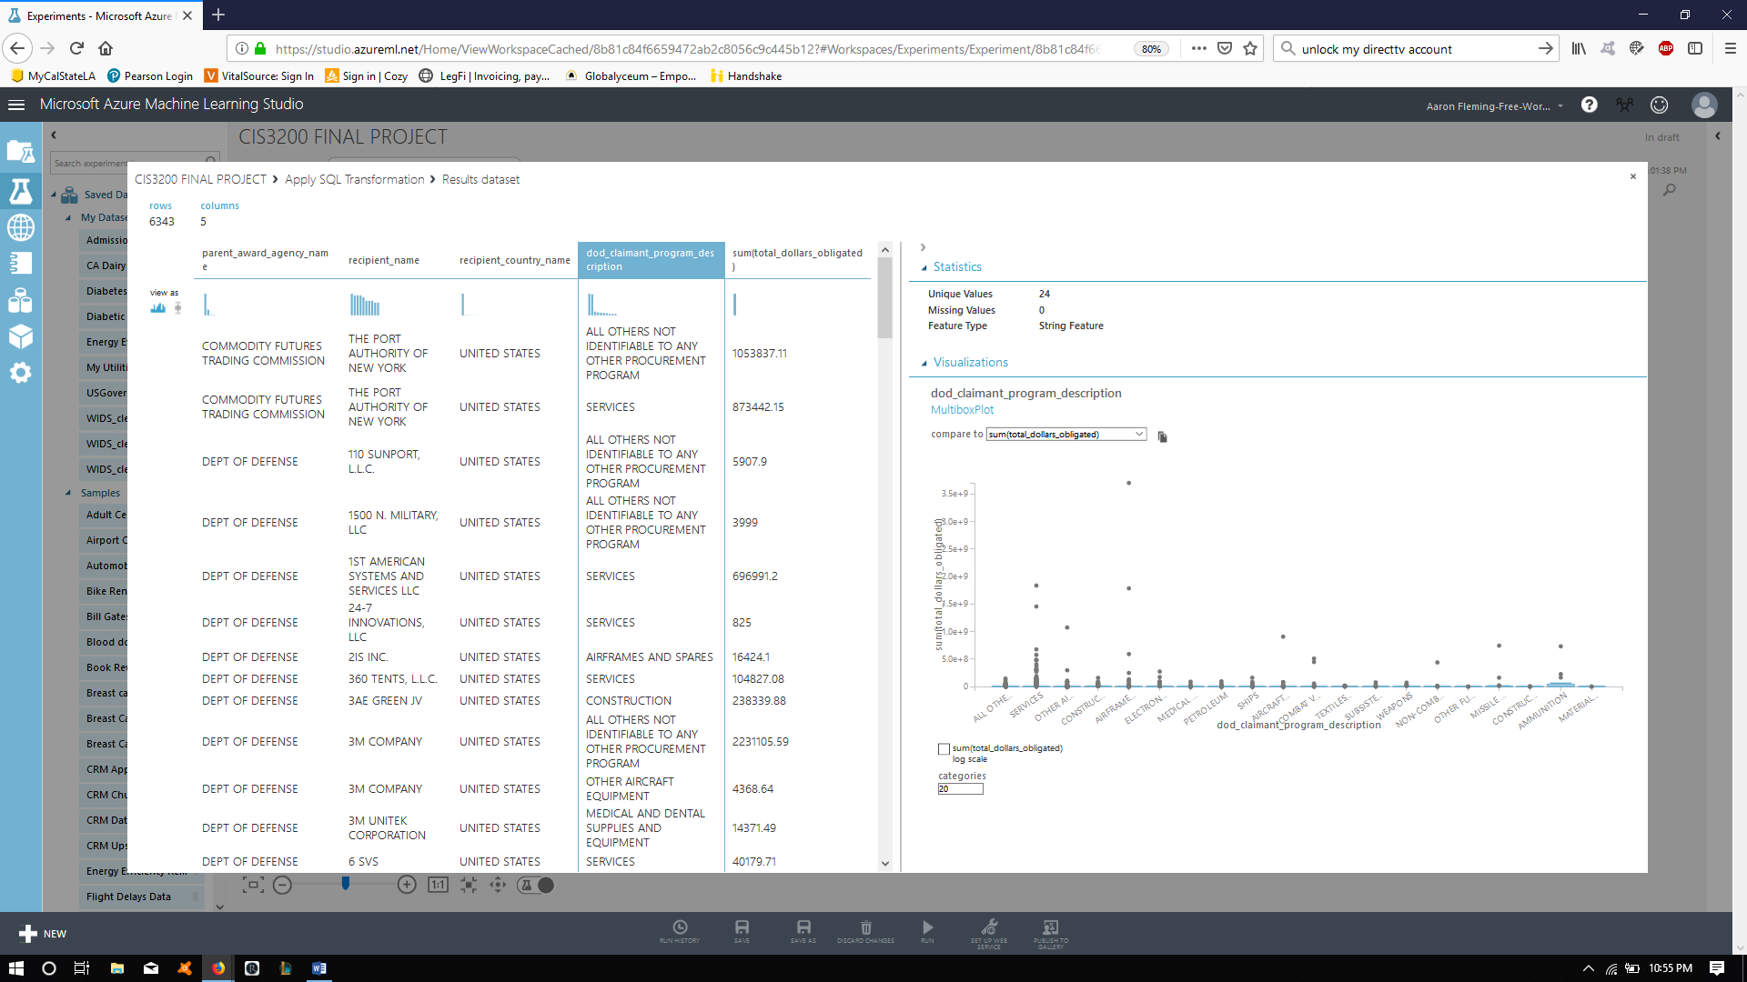

Slide 19
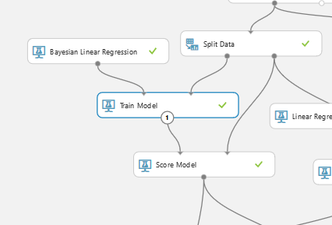
Train Model #1
Column names: total_dollars_obligated
Bayesian Linear Regressions used for training:
Regularization weight: 1
This will be the first set of values used for comparison.

Slide 20
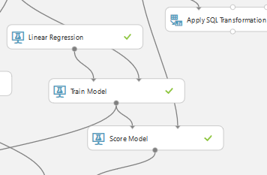
Train Model #2
Column names: current_total_value_of_awards
Linear Regression used for training:
Solution method: Ordinary Least Squares
All options set to default
This will be the second set of values used for comparison.

Slide 21
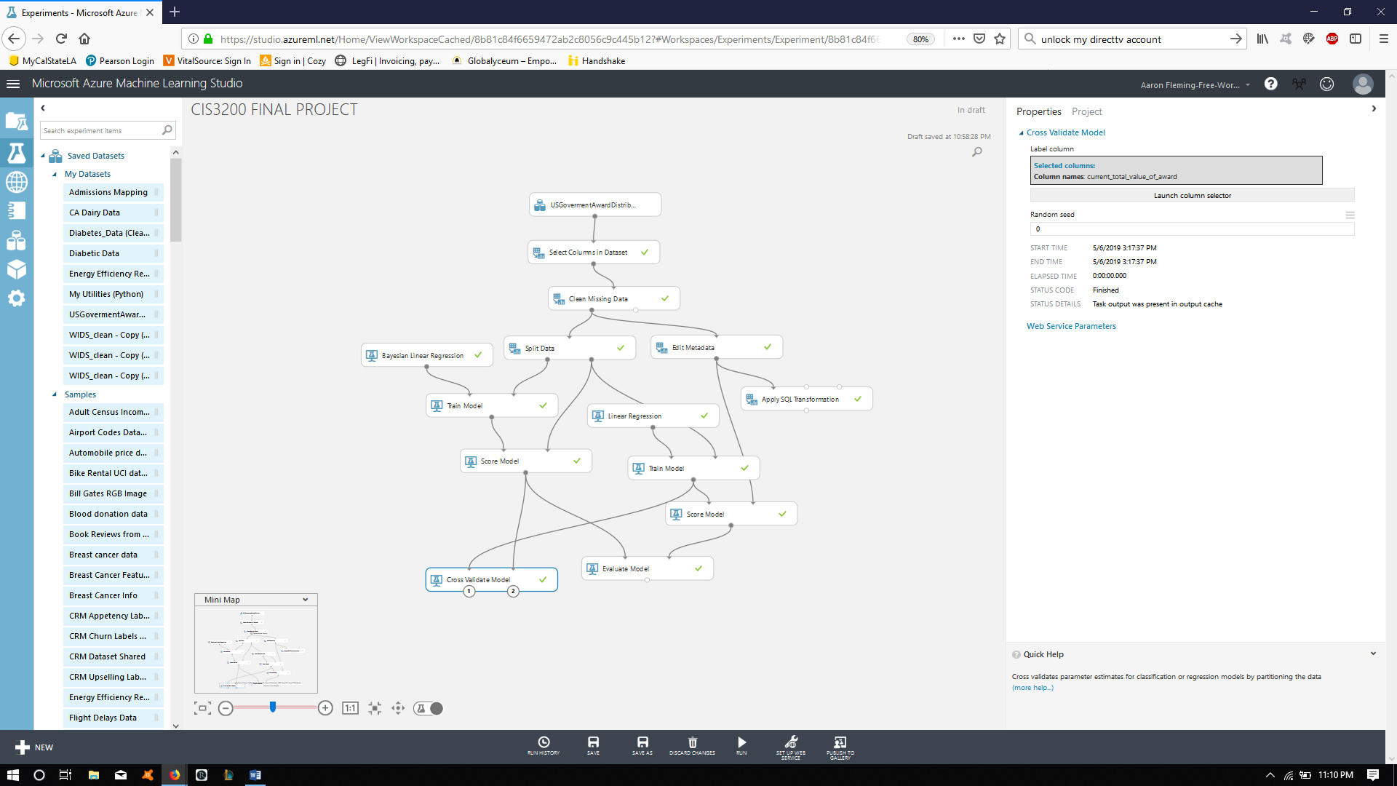

Slide 22
